Slide 1
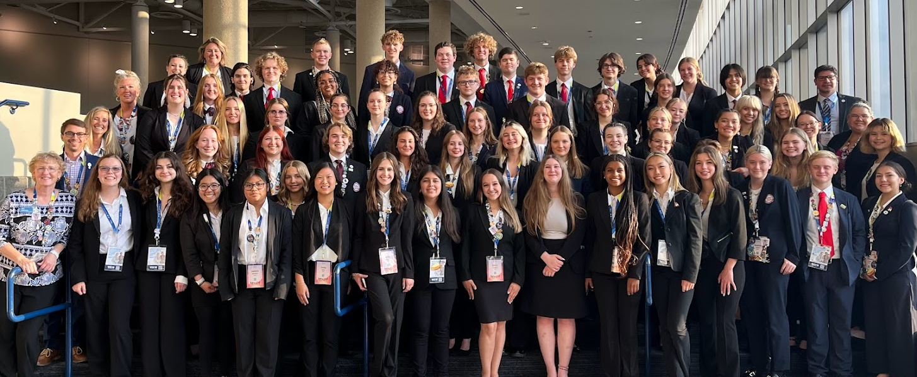
MMACHS HOSA
2025 Regional, State, and international leadership conferences

Slide 2
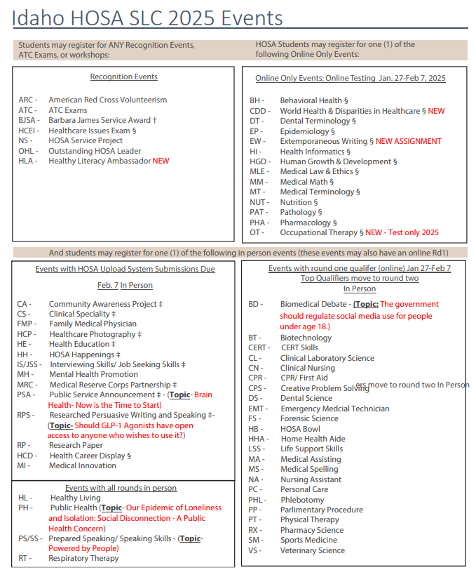

Slide 3
Regionals
Jan 24th – First Round Testing (4:30 – 7:30 p.m.)
January 25th – Second Round Events / Knowledge Tests
8:30 a.m. – 4:30 p.m. @ Dennis Technical Education Center
Based on student appointment time
Participation is mandatory in order to attend SLC
Placement is NOT mandatory to attend state
Specific appointment times posted week of:
Students must check in at MMACHS Booster table when they arrive. They may leave after their second event is complete

Slide 4
State Leadership Conference (SLC)
March 5-7th, 2025
Committed by January 17th (responsible for $)
$100 fees due by February 27th
Unless 20 boxes of potatoes
Grade Check February 27th (No more than 1 WIP)
MUST attend closing ceremonies on March 7th to qualify for ILC
Online tests after school beginning January 27th (Times posted on Schoology)
MUST TAKE TEST ON POSTED DATE!

Slide 5
SLC Continued
March 5th – Arrive at school normal time
Bus leaves around 8:15
One stop in Twin Falls, ID for restroom, snacks
Hotel: Home2Suites
Four students to a room
Gender → Grade Level → Teammates
Activities:
Competitions
Symposiums
General Sessions
HOSA Night:
Student Union Building closed to anyone but HOSA members: Rock climbing, dance, bowling, movie theater, etc.
Things to Pack:
One suitcase and one “carry on”
PRO DRESS!
Clothes for three days
Bathing suit
Chaperones: ~13 MMACHS staff

Slide 6
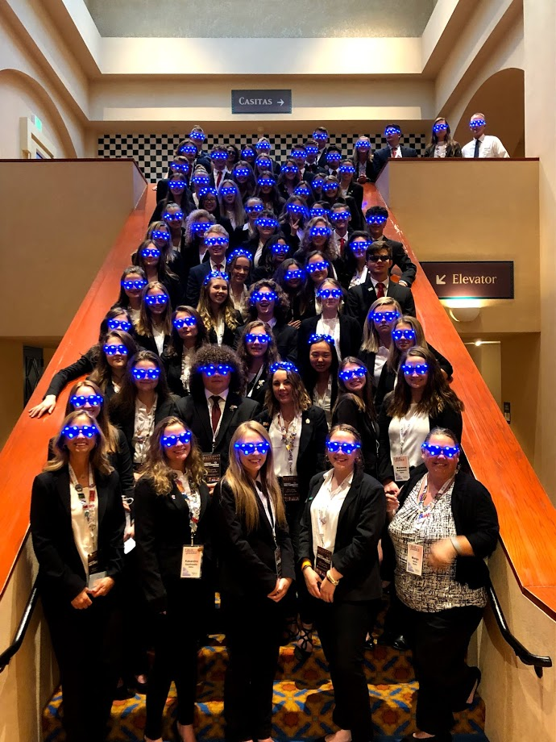
International Leadership Conference (ILC)
ILC Parent Meeting, Tuesday, March 11th @ 6 pm
June 17 – June 22, 2025; Nashville, TN
Will need confirmation paperwork & $100 deposit by March 14th, 2024.
We take all grade levels, discuss travel & funding now! ILC conflicts w/ summer school; must pass classes!

Slide 7
Questions?
Check www.hosa.org
Frequent http://www.meridianmedicalartscharter.org/hosa/
Donate at http://www.meridianmedicalartscharter.org/giving/
Email Blake Gaudet gaudet.blake@westada.org
or Jonathan Skaar, skaar.jonathan@westada.org
THANK YOU!!!!!

